Slide 1
VOCABULARY
What is a Scientist?

Slide 2
Process Skills
The science process skills form the foundation for scientific methods. There are six basic science process skills:
• Observation • Measurement
• Communication • Inference
• Classification • Prediction
http://www.longwood.edu/cleanva/images/sec6.processskills.pdf

Slide 3
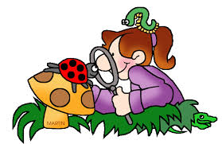
Observation
The process of noting and recording data for scientific investigation.

Slide 4
Communication
The transferring of messages or exchanging of information or ideas.

Slide 5
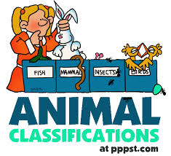
Classification
Placing plants and animals in groups based on structure and other criteria.

Slide 6
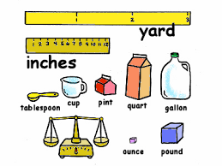
Measurement
The specific dimension (size, weight) of something.

Slide 7
Inference
To make a conclusion based on evidence or logic.

Slide 8
Prediction
The act of foretelling
Making a guess

Slide 9
Questions
Requesting information.

Slide 10
Selects
To choose as a preference.

Slide 11
Tools
An instrument used for doing work.

Slide 12
Compare
To note the likeness and differences.

Slide 13
Graphs
Shows the relationship between two or more nouns. Lines, bars, dots, ect.

Slide 14
Charts
Display of information in a graph form.

Slide 15
Illustrate
Provide a picture.

Slide 16
Sort
Group things by their attributes.

Slide 17
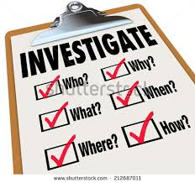
Investigate
To make a full inquiry; question

